Slide 1
EASTER

Slide 2
WHAT IS EASTER
EASTER IS CATHOLIC FEAST
CELEBRATE IN SPRING
NO DAY IS SET
FAMILY GATHERING

Slide 3
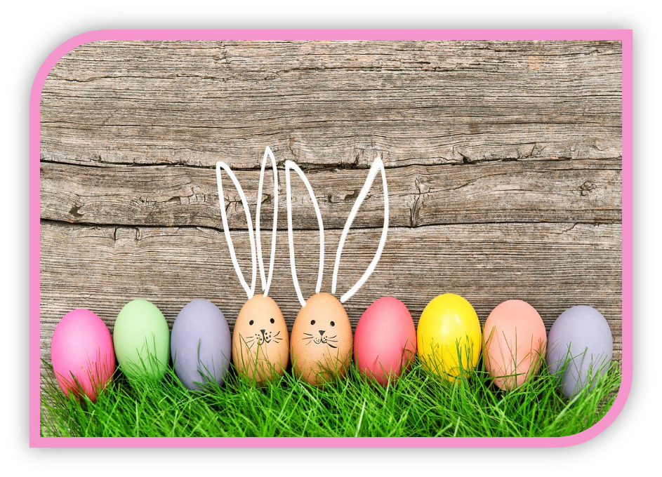
EASTER CUSTOMS
EGGS COLORING
BANGING EGGS
DEDICATION OF FOOD
GOING TO MASS

Slide 4
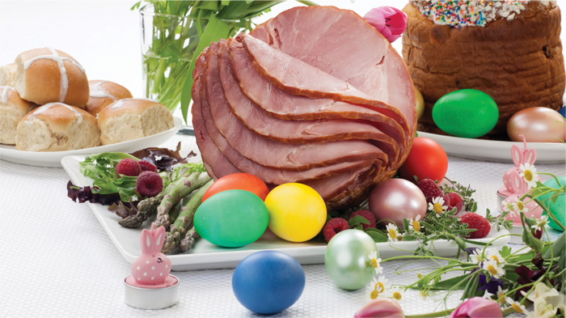
EASTER FOOD
COOKED HAM
COOKED EGGS
YOUNG ONIONS
RADISH
HAM IN BREAD
CAKES

Slide 5
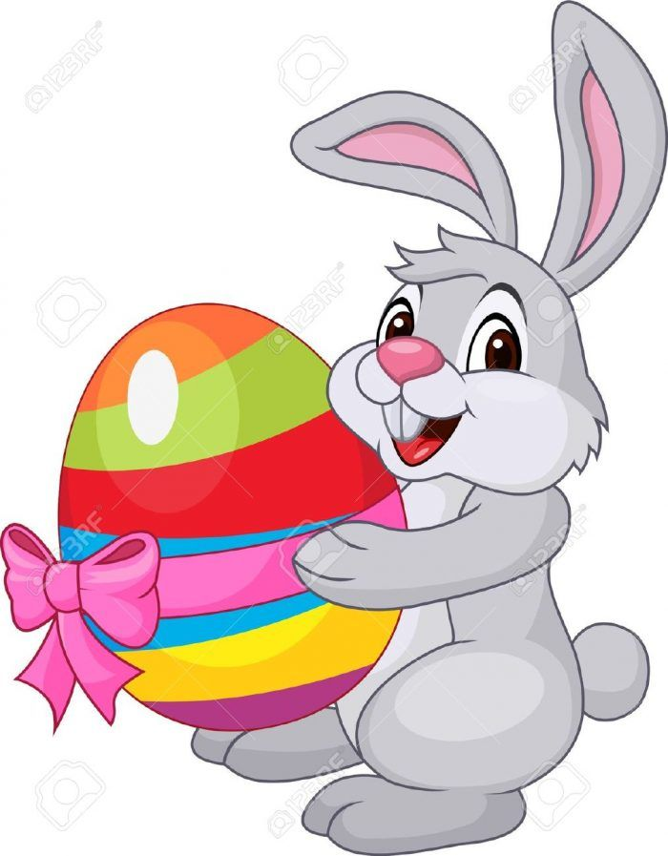
SYMBOLS OF EASTER
RABBIT
AND
CHICKEN

