Slide 1
SMOKING
Silvia belečić, 6.r

Slide 2
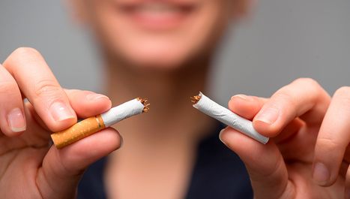
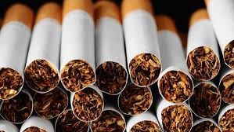
ON SMOKING
a way of consuming tobacco taken in the form of cigars ,cigarettes (small cigars wrapped in paper), cigarillos, and using a pipe.
another form of tobacco consumption is chewing and snorting
smoking also creates tar, undiluted nicotine-free condensate smoke, smoking is a dangerous habit for human health because it has a detrimental effect on the circulatory system and lungs
In Croatia, the sale of tobacco products to children under the age of 18 is prohibited, but there are many cases when primary school children smoke from the age of thirteen, which is then very harmful to health, much more so than to the health of an adult

Slide 3
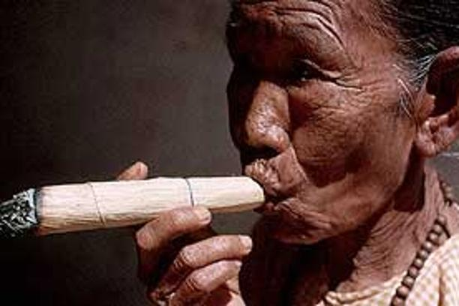
HISTORY OF SMOKING
it was common among various ancient American cultures and had primarily ritual significance
the first information about smoking was recorded in the diary of Christopher Columbus on November 6, 1492, where it is described how the Indians roll a leaf of tobacco and burn it on one side, and on the other they inhale smoke into the lungs and then exhale it
the first smokers in Europe were Columbus' sailors, and the Spaniards were the first Europeans to grow tobacco in their overseas colonies in 1595 and import it into Europe under the name "tobacco".
smoking then spread to Europe.

Slide 4
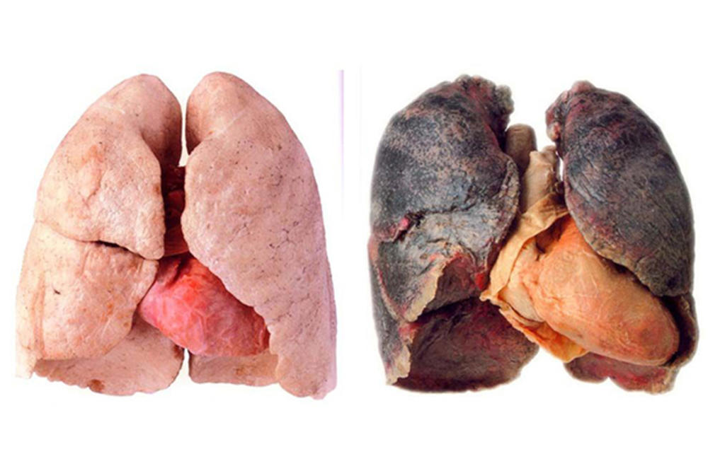
The effects of smoking on the body
smoking is a major risk factor for developing cancers of the bronchi and lungs, larynx, pharynx, oral cavity, esophagus, kidneys, bladder, pancreas, and cervical cancer and some forms of leukemia are more common in smokers.
it doesn't matter if you are an active or passive smoke
in patients with asthma, passive smoking causes discomfort, even a direct asthma attack, and in infants and young children leads to more frequent bronchitis, pneumonia, asthma, other respiratory diseases and reduced lung function, and acute and chronic otitis media.
sudden Infant Death Syndrome is also more common in infants exposed to tobacco smoke

Slide 5
LITERATURE
Google Chrome, Wikipedia

Slide 6
THANK YOU FOR ATTENTION

